Slide 1
CSC 3342 Computer Graphics
Chapter 1
Introduction

Slide 2
Contact Information
Instructor
Jinghua Zhang, Ph.D.
Email: zhangj@wssu.edu
Office:EJJCS 3213
Office Hours: MW 9:30am-12:30pm
Other times by appointment
Course materials will be posted on the blackboard

Slide 3
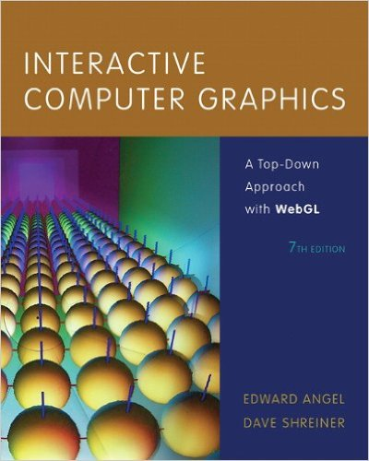
Textbook
Interactive Computer Graphics: A Top-Down Approach with WebGL
Author: Edward Angel
Publisher: Addison-Wesley; 7th edition
ISBN: 978-0133574845
Web resources
www.opengl.org
get.webgl.org
www.chromeexperiments.com/webgl
learningwebgl.com

Slide 4
Overview
Graphics systems and models
Graphics programming
Interaction and Animation
Geometric objects and transformations
Viewing

Slide 5
Course Objectives
Broad introduction to Computer Graphics
Software
Hardware
Applications
Top-down approach
Shader-Based WebGL
Integrates with HTML5
Javascript
Code runs in latest browser

Slide 6
Prerequisites
Good programming skills in C (or C++)
Basic Data Structures
Linked lists
Arrays
Geometry
Simple Linear Algebra

Slide 7
Why is this course different?
Shader-based
Most computer graphics use OpenGL but still use fixed-function pipeline
does not require shaders
Does not make use of the full capabilities of the graphics processing unit (GPU)
Web
With HTML5, WebGL runs in the latest browsers
makes use of local hardware
no system dependencies

Slide 8
Example: Draw a triangle
Each application consists of (at least) two files
HTML file and a JavaScript file
HTML
describes page
includes utilities
includes shaders
JavaScript
contains the graphics

Slide 9
Coding in WebGL
Can run WebGL on any recent browser
Chrome
Firefox
Safari
IE
Code written in JavaScript
JS runs within browser
Use local resources

Slide 10
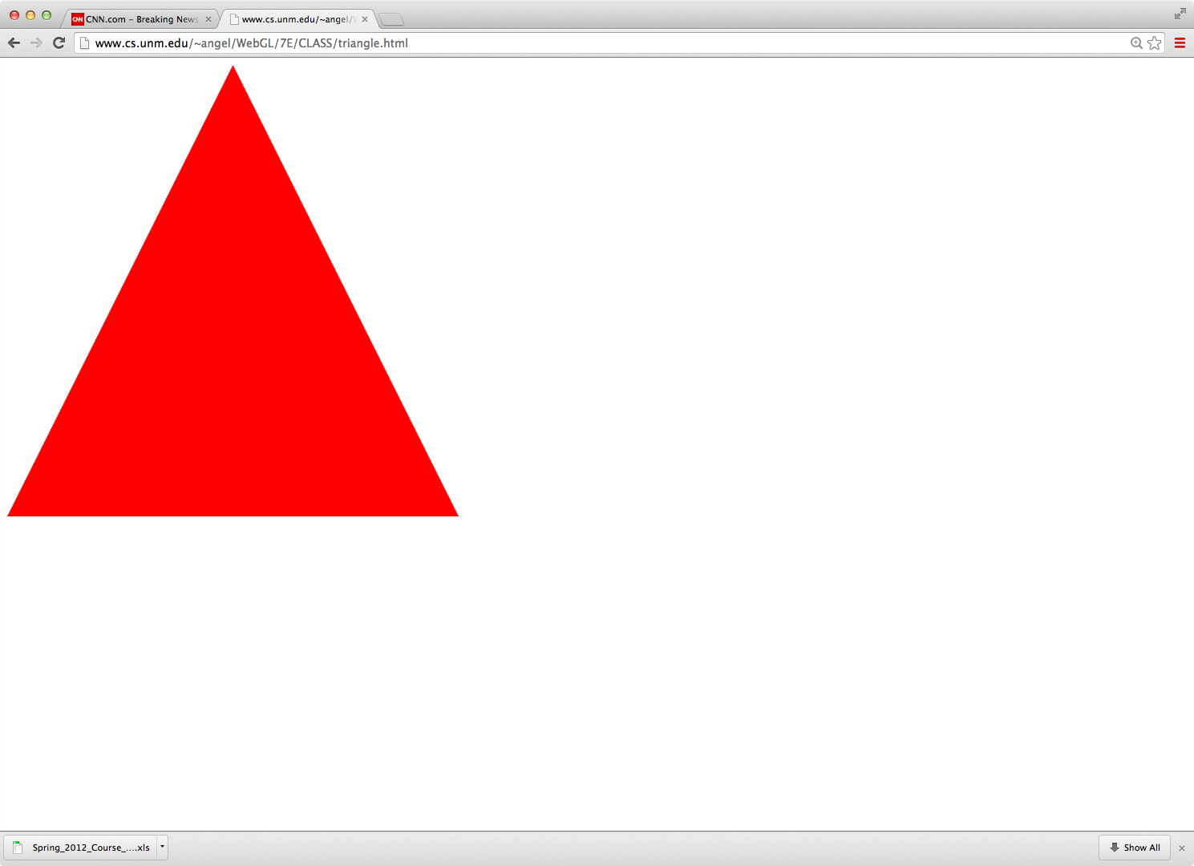
Example: triangle.html

Slide 11
Example Code
<!DOCTYPE html>
<html>
<head>
<script id="vertex-shader" type="x-shader/x-vertex">
attribute vec4 vPosition;
void main(){
gl_Position = vPosition;
}
</script>
<script id="fragment-shader" type="x-shader/x-fragment">
precision mediump float;
void main(){
gl_FragColor = vec4( 1.0, 0.0, 0.0, 1.0 );
}
</script>

Slide 12
HTML File (cont)
<script type="text/javascript" src=“webgl-utils.js"></script>
<script type="text/javascript" src=“initShaders.js"></script>
<script type="text/javascript" src=”MV.js"></script>
<script type="text/javascript" src="triangle.js"></script>
</head>
<body>
<canvas id="gl-canvas" width="512" height="512">
Oops ... your browser doesn't support the HTML5 canvas element
</canvas>
</body>
</html>

Slide 13
JS File
var gl;
var points;
window.onload = function init(){
var canvas = document.getElementById( "gl-canvas" );
gl = WebGLUtils.setupWebGL( canvas );
if ( !gl ) {
alert( "WebGL isn't available" );
}
// Three Vertices
var vertices = [ vec2( -1, -1 ), vec2( 0, 1 ), vec2( 1, -1 ) ];
// Configure WebGL
gl.viewport( 0, 0, canvas.width, canvas.height );
gl.clearColor( 1.0, 1.0, 1.0, 1.0 );
// Load shaders and initialize attribute buffers
var program = initShaders( gl, "vertex-shader", "fragment-shader" );
gl.useProgram( program );

Slide 14
JS File (cont)
// Load the data into the GPU
var bufferId = gl.createBuffer();
gl.bindBuffer( gl.ARRAY_BUFFER, bufferId );
gl.bufferData( gl.ARRAY_BUFFER, flatten(vertices), gl.STATIC_DRAW );
// Associate out shader variables with our data buffer
var vPosition = gl.getAttribLocation( program, "vPosition" );
gl.vertexAttribPointer( vPosition, 2, gl.FLOAT, false, 0, 0 );
gl.enableVertexAttribArray( vPosition );
render();
};
function render() {
gl.clear( gl.COLOR_BUFFER_BIT );
gl.drawArrays( gl.TRIANGLES, 0, 3 );
}

Slide 15
Exercise
Run triangle.html
Load the triangle.html and triangle.js to your computer and run them from there
Edit the two files to
Display two triangles and one square
Change the background color
Change the color of triangles

Slide 16
JS Notes
JavaScript (JS) is the language of the Web
All browsers will execute JS code
JavaScript is an interpreted object-oriented language
References
Flanagan, JavaScript: The Definitive Guide, O’Reilly
Crockford, JavaScript, The Good Parts, O’Reilly
Many Web tutorials

Slide 17
JS Notes
Is JS slow?
JS engines in browsers are getting much faster
Not a key issues for graphics since once we get the data to the GPU it doesn’t matter how we got the data there
JS is a (too) big language
We don’t need to use it all
Choose parts we want to use
Don’t try to make your code look like C or Java

Slide 18
JS Notes
Very few native types:
numbers
strings
booleans
Only one numerical type: 32 bit float
var x = 1;
var x = 1.0; // same
potential issue in loops
two operators for equality == and ===
Dynamic typing

Slide 19
Scoping
Different from other languages
Function scope
variables are hoisted within a function
can use a variable before it is declared
Note functions are first class objects in JS

Slide 20
JS Arrays
JS arrays are objects
inherit methods
var a = [1, 2, 3];
is not the same as in C++ or Java
a.length // 3
a.push(4); // length now 4
a.pop(); // 4
avoids use of many loops and indexing
Problem for WebGL which expects C-style arrays

Slide 21
Typed Arrays
JS has typed arrays that are like C arrays
var a = new Float32Array(3)
var b = new Uint8Array(3)
Generally, we prefer to work with standard JS arrays and convert to typed arrays only when we need to send data to the GPU with the flatten function in MV.js

Slide 22
A Minimalist Approach
We will use only core JS and HTML
no extras or variants
No additional packages
CSS
JQuery
Focus on graphics
examples may lack beauty
You are welcome to use other variants as long as I can run them from your URL

Slide 23
What is Computer Graphics?
Computer graphics deals with all aspects of creating images with a computer
Hardware
Software
Applications

Slide 24
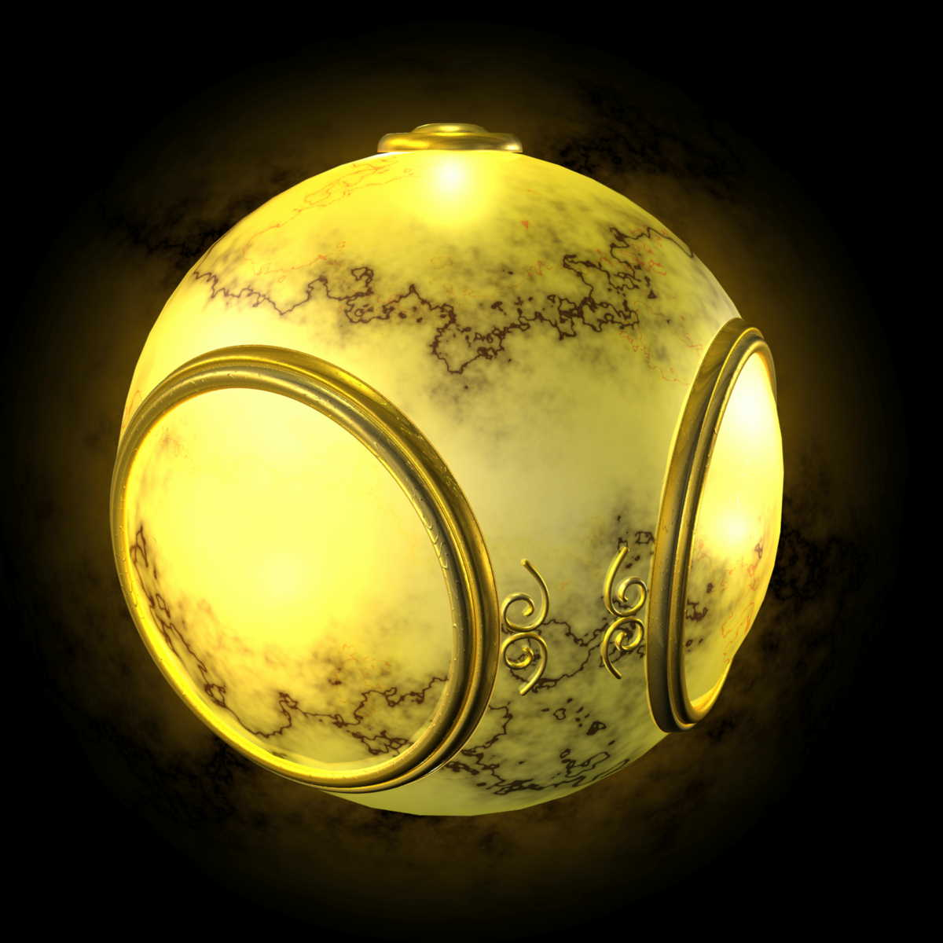
Example
Where did this image come from?
What hardware/software did we need to produce it?

Slide 25
Preliminary Answer
Application: The object is an artist’s rendition of the sun for an animation to be shown in a domed environment (planetarium)
Software: Maya for modeling and rendering but Maya is built on top of OpenGL
Hardware: PC with graphics card for modeling and rendering

Slide 26
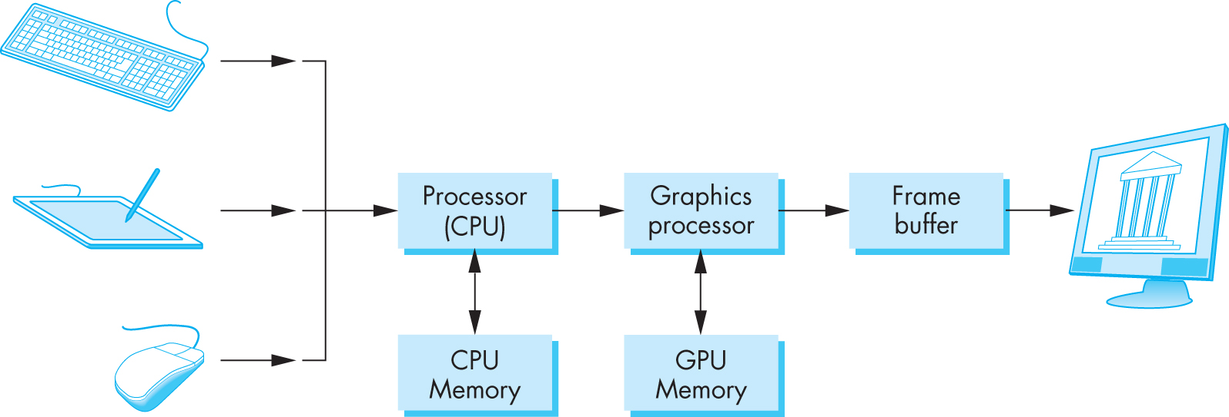
Basic Graphics System
Output device
Input devices
Image formed in frame buffer

Slide 27
Computer Graphics: 1950-1960
Computer graphics goes back to the earliest days of computing
Strip charts
Pen plotters
Simple displays using A/D converters to go from computer to calligraphic CRT
Cost of refresh for CRT too high
Computers slow, expensive, unreliable

Slide 28
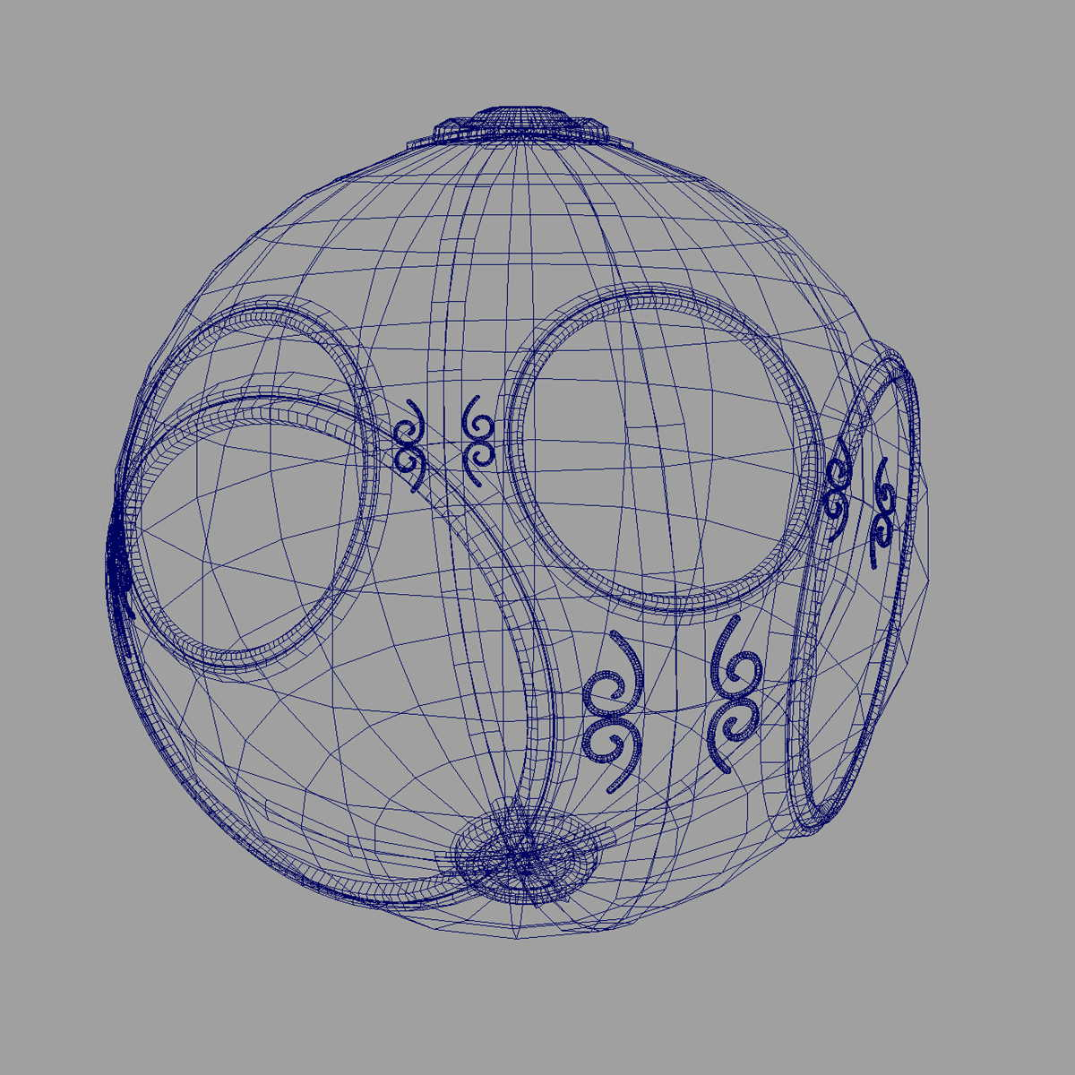
Computer Graphics: 1960-1970
Wireframe graphics
Draw only lines
Sketchpad
Display Processors
Storage tube
wireframe representation
of sun object

Slide 29
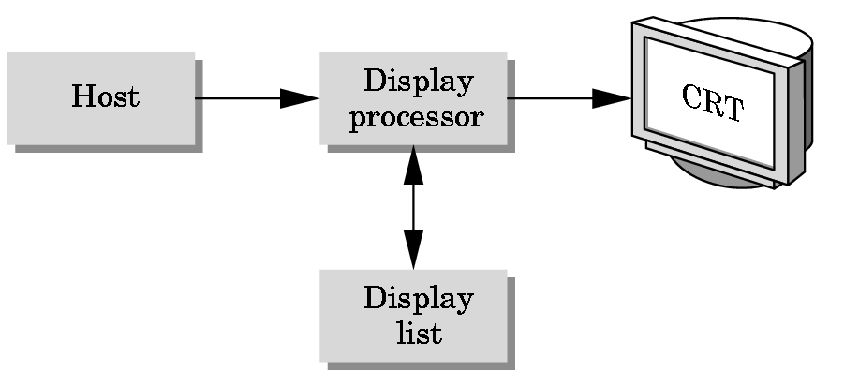
Display Processor
Rather than have the host computer try to refresh display use a special purpose computer called a display processor (DPU)
Graphics stored in display list (display file) on display processor
Host compiles display list and sends to DPU

Slide 30
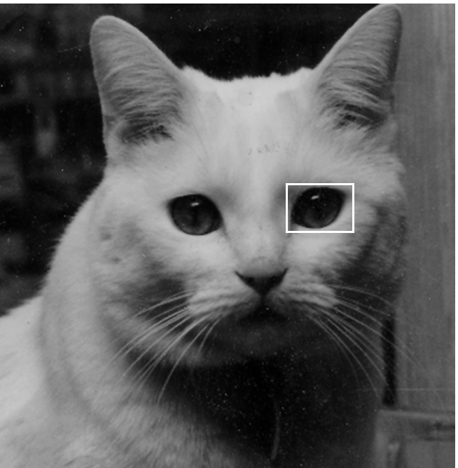
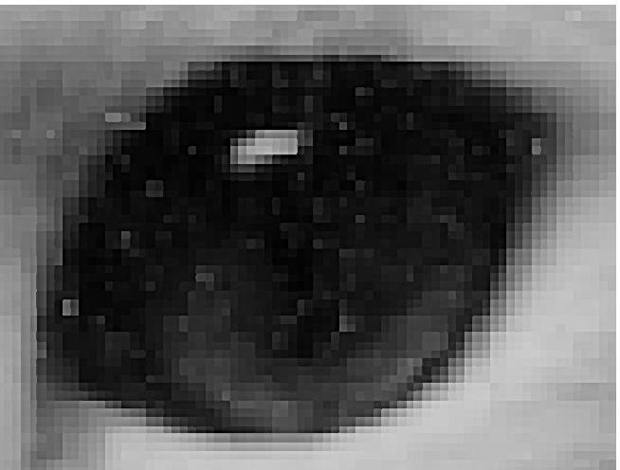
Computer Graphics: 1970-1980
Raster Graphics
Image produced as an array (the raster) of picture elements (pixels) in the frame buffer

Slide 31
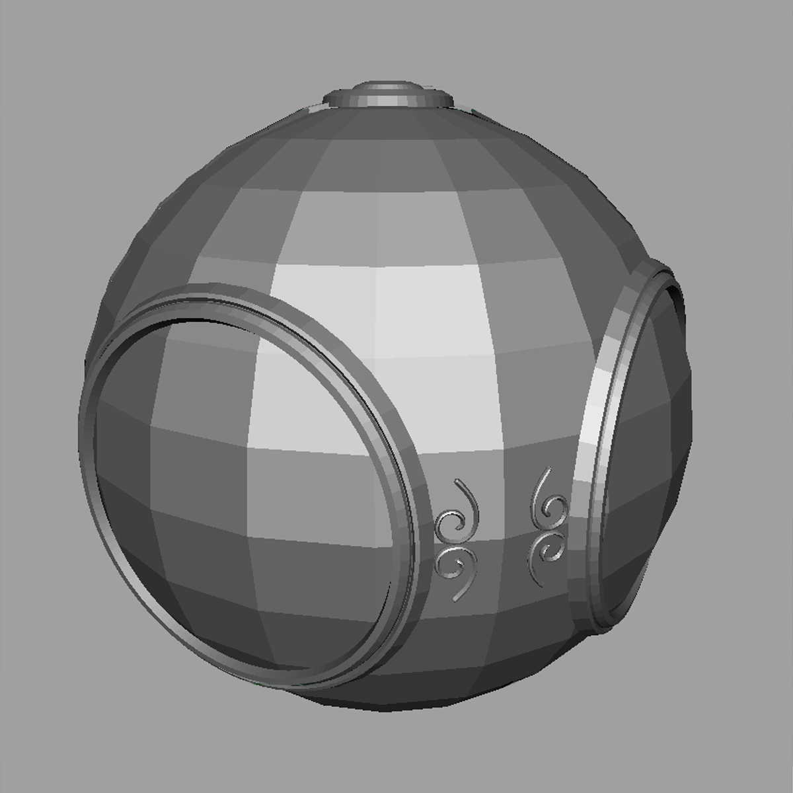
Raster Graphics
Allows us to go from lines and wire frame images to filled polygons

Slide 32
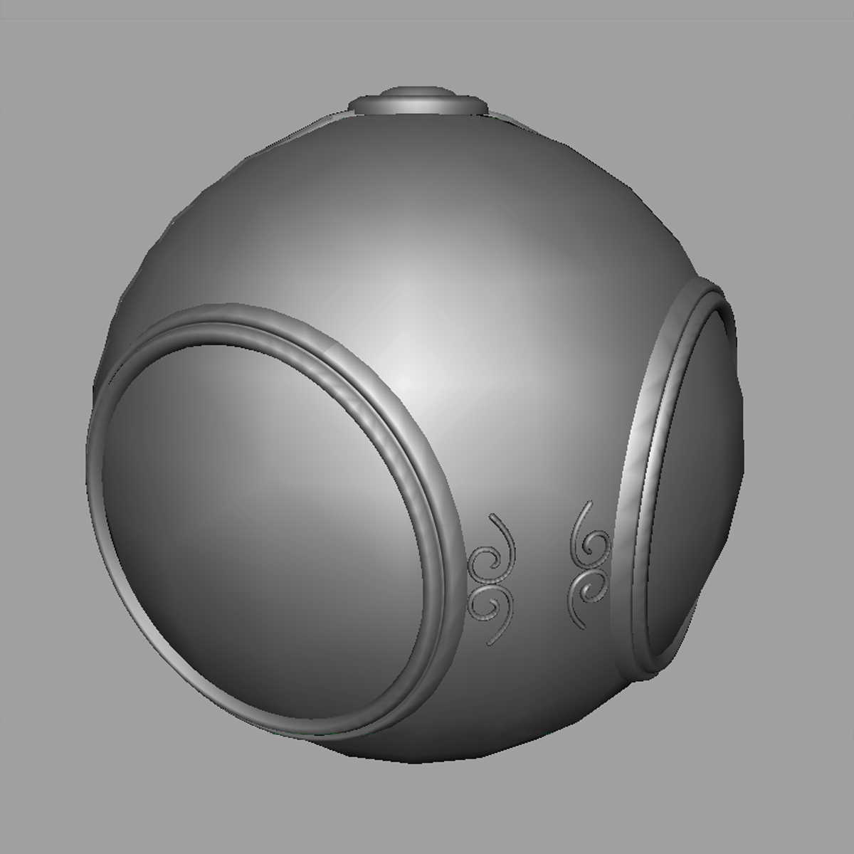
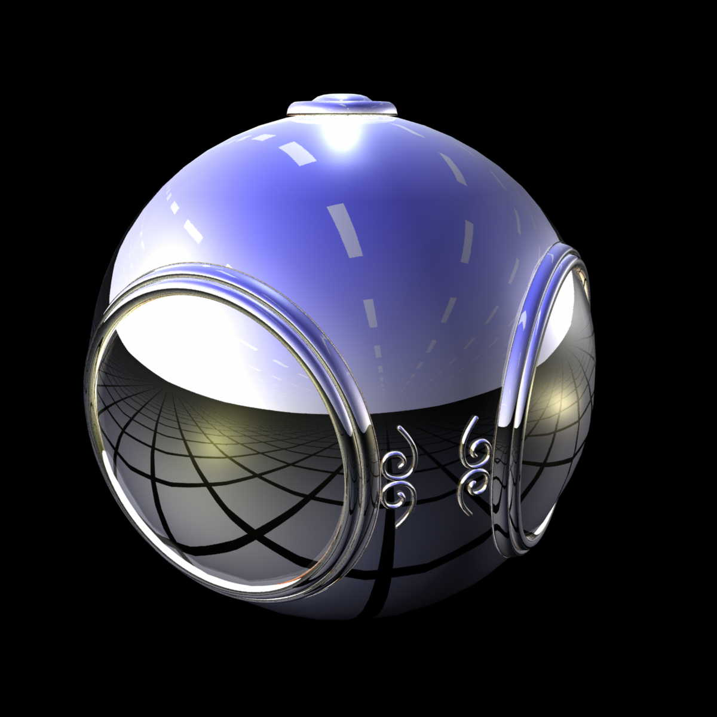
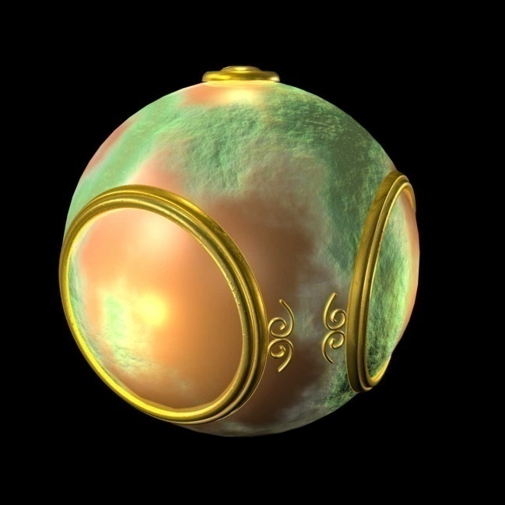
Computer Graphics: 1980-1990
Realism comes to computer graphics
smooth shading
environment
mapping
bump mapping

Slide 33
Computer Graphics: 1980-1990
Special purpose hardware
Silicon Graphics geometry engine
VLSI implementation of graphics pipeline
Industry-based standards
PHIGS
RenderMan
Networked graphics: X Window System
Human-Computer Interface (HCI)

Slide 34
Computer Graphics: 1990-2000
OpenGL API
Completely computer-generated feature-length movies (Toy Story) are successful
New hardware capabilities
Texture mapping
Blending
Accumulation, stencil buffers

Slide 35
Computer Graphics: 2000-
Photorealism
Graphics cards for PCs dominate market
Nvidia, ATI, 3DLabs
Game boxes and game players determine direction of market
Computer graphics routine in movie industry: Maya, Lightwave
Programmable pipelines
New display technologies

Slide 36
Computer Graphics 2011-
Graphics is now ubiquitous
Cell phones
Embedded
OpenGL ES and WebGL
Alternate and Enhanced Reality
3D Movies and TV

Slide 37
Image Formation
In computer graphics, we form images which are generally two dimensional using a process analogous to how images are formed by physical imaging systems
Cameras
Microscopes
Telescopes
Human visual system

Slide 38
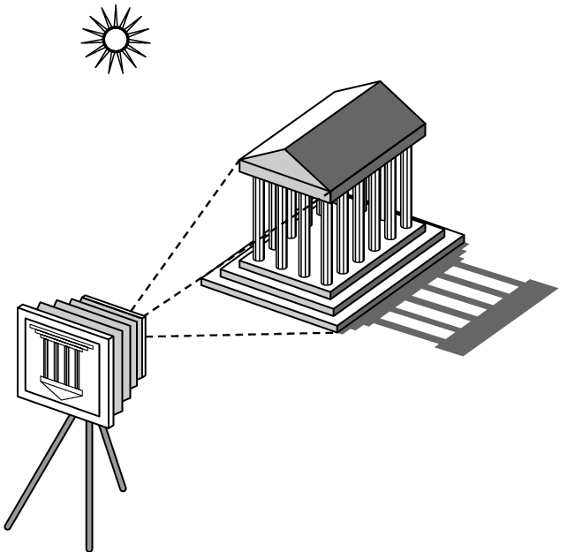
Elements of Image Formation
Objects
Viewer
Light source(s)
Attributes that govern how light interacts with the materials in the scene
Note the independence of the objects, the viewer, and the light source(s)

Slide 39
Light
Light is the part of the electromagnetic spectrum that causes a reaction in our visual systems
Generally these are wavelengths in the range of about 350-750 nm (nanometers)
Long wavelengths appear as reds and short wavelengths as blues

Slide 40
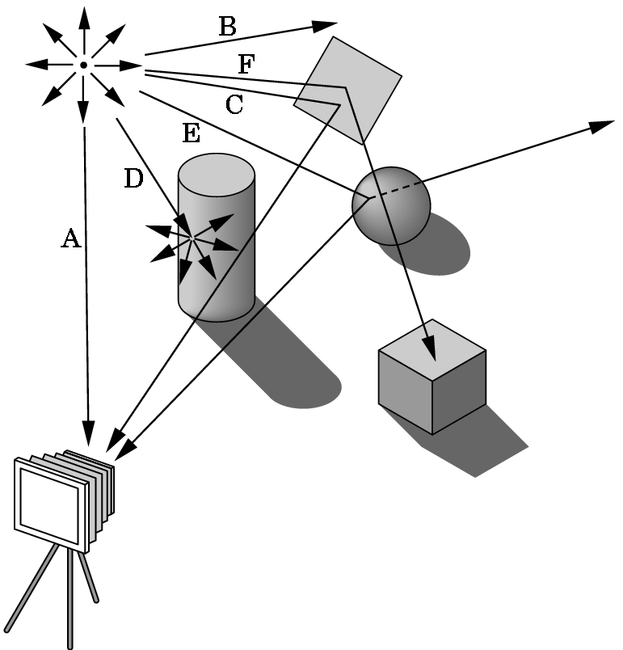
Ray Tracing and Geometric Optics
One way to form an image is to
follow rays of light from a
point source finding which
rays enter the lens of the
camera. However, each
ray of light may have
multiple interactions with objects
before being absorbed or going to infinity.

Slide 41
Luminance and Color Images
Luminance Image
Monochromatic
Values are gray levels
Analogous to working with black and white film or television
Color Image
Has perceptional attributes of hue, saturation, and lightness
Do we have to match every frequency in visible spectrum? No!

Slide 42
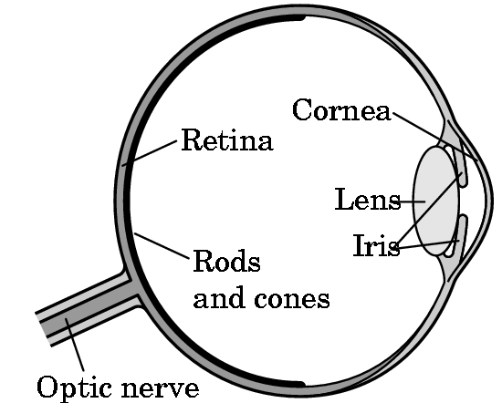
Three-Color Theory
Human visual system has two types of sensors
Rods: monochromatic, night vision
Cones
Color sensitive
Three types of cones
Only three values (the tristimulus
values) are sent to the brain
Need only match these three values
Need only three primary colors

Slide 43
Additive and Subtractive Color
Additive color
Form a color by adding amounts of three primaries
CRTs, projection systems, positive film
Primaries are Red (R), Green (G), Blue (B)
Subtractive color
Form a color by filtering white light with cyan (C), Magenta (M), and Yellow (Y) filters
Light-material interactions
Printing
Negative film

Slide 44
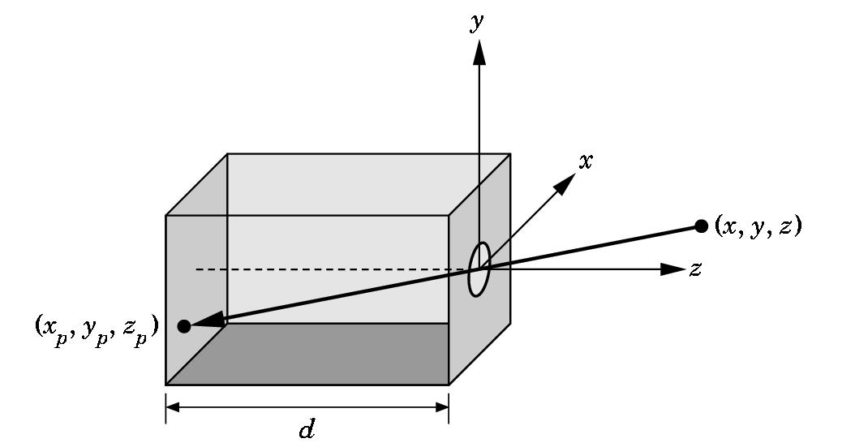
Pinhole Camera
Use trigonometry to find projection of point at (x,y,z)
x_{p}= -x/z/d
y_{p}= -y/z/d
z_{p}= d
These are equations of simple perspective

Slide 45
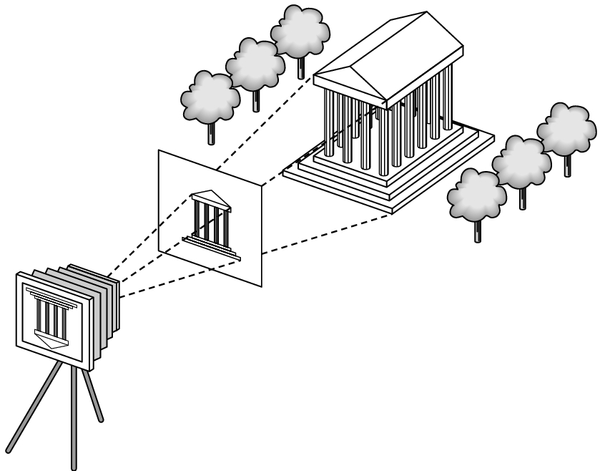
Synthetic Camera Model
projector
p
image plane
projection of p
center of projection

Slide 46
Advantages
Separation of objects, viewer, light sources
Two-dimensional graphics is a special case of three-dimensional graphics
Leads to simple software API
Specify objects, lights, camera, attributes
Let implementation determine image
Leads to fast hardware implementation

Slide 47
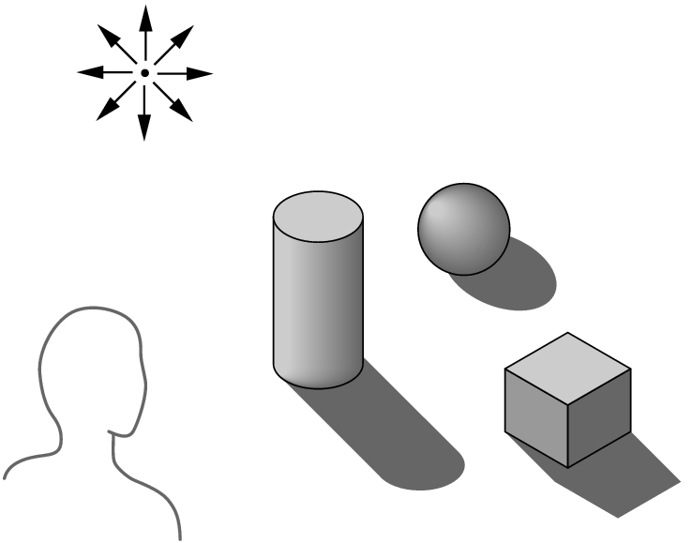
Global vs Local Lighting
Cannot compute color or shade of each object independently
Some objects are blocked from light
Light can reflect from object to object
Some objects might be translucent

Slide 48
Why not ray tracing?
Ray tracing seems more physically based so why don’t we use it to design a graphics system?
Possible and is actually simple for simple objects such as polygons and quadrics with simple point sources
In principle, can produce global lighting effects such as shadows and multiple reflections but ray tracing is slow and not well-suited for interactive applications
Ray tracing with GPUs is close to real time

Slide 49
Models and Architecture

Slide 50
Objectives
Learn the basic design of a graphics system
Introduce pipeline architecture
Examine software components for an interactive graphics system

Slide 51
Image Formation Revisited
Can we mimic the synthetic camera model to design graphics hardware software?
Application Programmer Interface (API)
Need only specify
Objects
Materials
Viewer
Lights
But how is the API implemented?

Slide 52
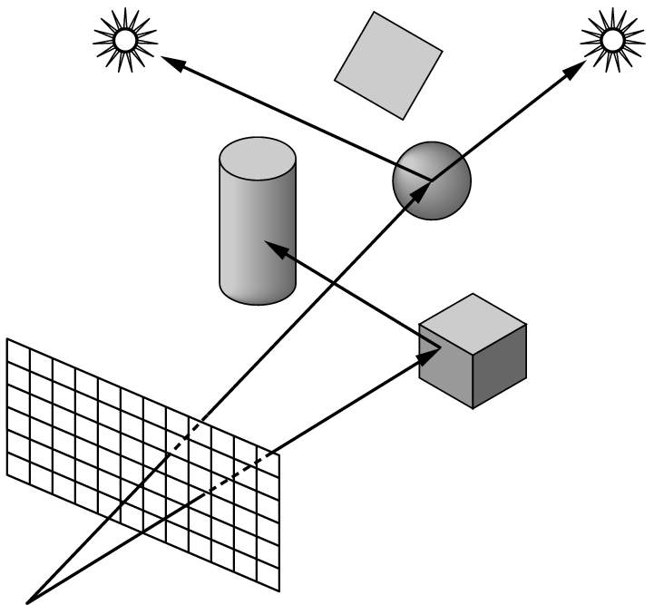
Physical Approaches
Ray tracing: follow rays of light from center of projection until they either are absorbed by objects or go off to infinity
Can handle global effects
Multiple reflections
Translucent objects
Slow
Must have whole data base
available at all times
Radiosity: Energy based approach
Very slow

Slide 53
Practical Approach
Process objects one at a time in the order they are generated by the application
Can consider only local lighting
Pipeline architecture
All steps can be implemented in hardware on the graphics card
application
program
display

Slide 54
Vertex Processing
Much of the work in the pipeline is in converting object representations from one coordinate system to another
Object coordinates
Camera (eye) coordinates
Screen coordinates
Every change of coordinates is equivalent to a matrix transformation
Vertex processor also computes vertex colors

Slide 55
Projection
Projection is the process that combines the 3D viewer with the 3D objects to produce the 2D image
Perspective projections: all projectors meet at the center of projection
Parallel projection: projectors are parallel, center of projection is replaced by a direction of projection

Slide 56
Primitive Assembly
Vertices must be collected into geometric objects before clipping and rasterization can take place
Line segments
Polygons
Curves and surfaces

Slide 57
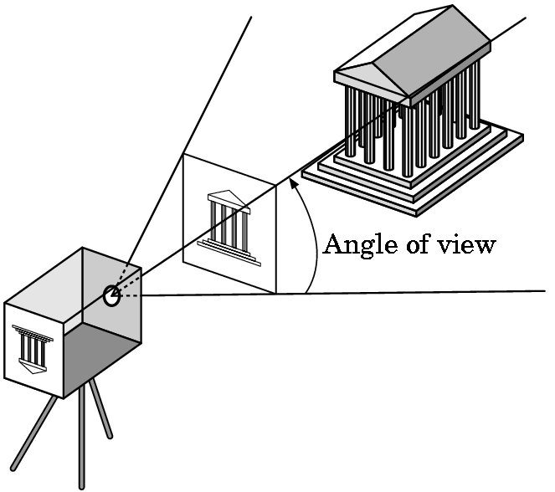
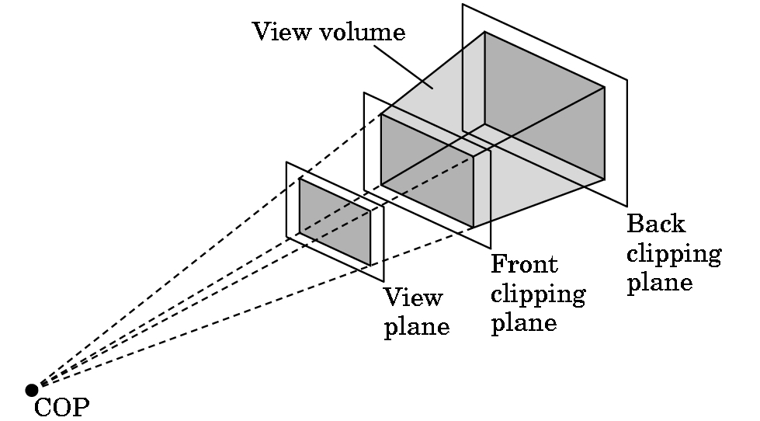
Clipping
Just as a real camera cannot “see” the whole world, the virtual camera can only see part of the world or object space
Objects that are not within this volume are said to be clipped out of the scene

Slide 58
Rasterization
If an object is not clipped out, the appropriate pixels in the frame buffer must be assigned colors
Rasterizer produces a set of fragments for each object
Fragments are “potential pixels”
Have a location in frame bufffer
Color and depth attributes
Vertex attributes are interpolated over objects by the rasterizer

Slide 59
Fragment Processing
Fragments are processed to determine the color of the corresponding pixel in the frame buffer
Colors can be determined by texture mapping or interpolation of vertex colors
Fragments may be blocked by other fragments closer to the camera
Hidden-surface removal

Slide 60
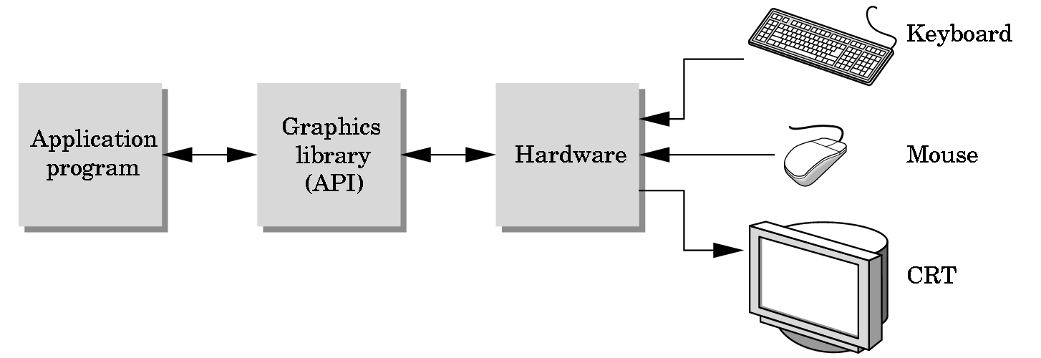
The Programmer’s Interface
Programmer sees the graphics system through a software interface: the Application Programmer Interface (API)

Slide 61
API Contents
Functions that specify what we need to form an image
Objects
Viewer
Light Source(s)
Materials
Other information
Input from devices such as mouse and keyboard
Capabilities of system

Slide 62
Object Specification
Most APIs support a limited set of primitives including
Points (0D object)
Line segments (1D objects)
Polygons (2D objects)
Some curves and surfaces
Quadrics
Parametric polynomials
All are defined through locations in space or vertices

Slide 63
Example (old style)
type of object
location of vertex
glBegin(GL_POLYGON)
glVertex3f(0.0, 0.0, 0.0);
glVertex3f(0.0, 1.0, 0.0);
glVertex3f(0.0, 0.0, 1.0);
glEnd( );
end of object definition

Slide 64
Example (GPU based)
Put geometric data in an array
Send array to GPU
Tell GPU to render as triangle
var points = [
vec3(0.0, 0.0, 0.0),
vec3(0.0, 1.0, 0.0),
vec3(0.0, 0.0, 1.0),
];

Slide 65
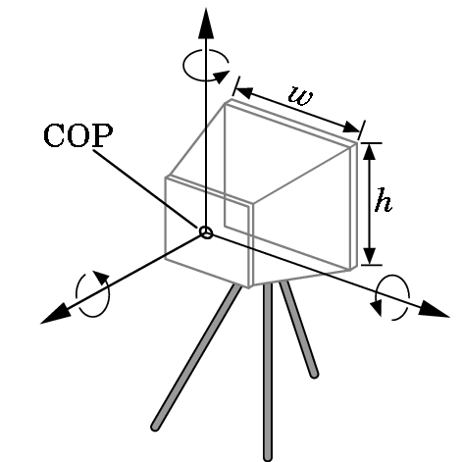
Camera Specification
Six degrees of freedom
Position of center of lens
Orientation
Lens
Film size
Orientation of film plane

Slide 66
Lights and Materials
Types of lights
Point sources vs distributed sources
Spot lights
Near and far sources
Color properties
Material properties
Absorption: color properties
Scattering
Diffuse
Specular

